Slide 1
PSCS-18 DASHBOARD FOR REAL-TIME MONITORING OF CONSTRUCTION PROJECTS
Review-3
Batch Number: CSE-G64
Under the Supervision of,
Dr. PRASAD P S
Assistant Professor ( Selection-Grade )
School of Computer Science and Engineering
Presidency University
Roll Number | Student Name
20211CSE0497 | YASHAS R GOWDA
20211CSE0843 | SHASHANK K
20211CSE0847 | DISHA S
Name of the Program: PSCS
Name of the HoD: Dr. ASIF MOHAMMED H B
Name of the Program Project Coordinator: Dr. JAYANTHI K
Name of the School Project Coordinators: Dr. SAMPATH A.K

Slide 2
CONTENT
Introduction
Literature Survey
Existing Methods-Drawbacks
Proposed Method
Objectives
Architecture Diagram
Hardware and Software Details
Time Line by Gantt Chart
Conclusion
Github link
References

Slide 3
INTRODUCTION
The construction industry is a complex and dynamic sector that requires meticulous planning, precise execution, and real-time monitoring to ensure projects are completed on time, within budget, and to the desired quality.
Traditional methods of project monitoring, such as manual reporting and periodic site visits, can be time-consuming, prone to errors, and often lead to delays and cost overruns. A real-time monitoring system can help address these challenges.
A real-time monitoring system can help address these challenges by providing a centralized platform for tracking progress, identifying potential issues, and enabling data-driven decision-making.
Our dashboard is designed to provide real-time insights and visibility into construction projects, empowering teams to work more efficiently, effectively, and collaboratively.

Slide 4
LITERATURE SURVEY
Web-Based Dashboards: Enhance real-time project tracking and collaboration.
→ Alwan et al. (2022), IEEE Xplore
IoT for Real-Time Monitoring: Improves worker safety, equipment tracking, and site surveillance.
→ Chen et al. (2019), Computers in Industry
AI & Predictive Analytics: Helps predict project delays, cost overruns, and labour shortages.
→ Singh & Bansal (2022), Journal of Computing in Civil Engineering
Big Data in Construction: Enhances scheduling efficiency and resource allocation.
→ Zhang & Zhou (2020), Automation in Construction

Slide 5
LITERATURE SURVEY
Blockchain for Secure Transactions: Ensures transparent contracts and secure payments.
→ Taylor & Harris (2018), International Journal of Project Management
Cloud-Based Collaboration: Improves accessibility, real-time updates, and cost efficiency.
→ Sun & Lu (2019), Construction Innovation
Digital Twin Technology: Enables real-time tracking through virtual construction models.
→ Patel & Gupta (2021), Advanced Engineering Informatics

Slide 6
EXISTING METHODS-DRAWBACKS
Existing Methods:
1. Manual Reporting: Construction teams submit progress reports manually, often through paper-based or spreadsheet-based systems.
2. Periodic Site Visits: Project managers and stakeholders conduct regular site visits to assess progress and identify issues.
3. Spreadsheets and Documents: Construction teams use spreadsheets and documents to track progress, manage schedules, and store project data.
4. Project Management Software: Traditional project management software, such as Asana, Trello, or MS Project, are used to manage tasks, schedules, and resources.

Slide 7
EXISTING METHODS-DRAWBACKS
Drawbacks:
1. Inaccurate or Outdated Information: Manual reporting and periodic site visits can lead to inaccurate or outdated information, making it difficult to make informed decisions.
2. Lack of Real-Time Visibility: Traditional methods often lack real-time visibility into project progress, making it challenging to identify and address issues promptly.
3. Inefficient Communication: Manual reporting and disparate systems can lead to inefficient communication among stakeholders, causing delays and misunderstandings.
4. Data Silos: Spreadsheets and documents can create data silos, making it difficult to access and analyze project data in a comprehensive manner.
5. Limited Analytics and Insights: Traditional methods often lack advanced analytics and insights, making it challenging to identify trends, patterns, and areas for improvement.

Slide 8
PROPOSED METHODS
Data Collection and Integration
Data Gathering: Collect data from project management software, construction databases, and on-site reports.
Real-Time Data Integration: Ensure real-time data flow into the dashboard for accurate decision-making.
Dynamic Visualizations
Interactive Visuals: Use JavaScript libraries like Chart.js or Recharts to display data.
Visualizing Key Metrics: Display budget utilization and project progress metrics in an engaging way.
User Interface and Experience
Intuitive Design: Build a user-friendly interface using React.js and Material-UI components.
Customization: Enable flexibility with customizable features for different construction projects.

Slide 9
OBJECTIVES
The project aims to achieve the following objectives:
Real-Time Resource Monitoring:
Provide live updates on manpower and equipment allocation, usage, and availability.
Task and Workflow Management:
Enable tracking of tasks' progress, status, deadlines, and assigned personnel.
Efficiency Metrics:
Display key metrics like resource utilization rates, task completion rates, and project budget adherence.
Interactive Dashboard:
Include charts, graphs, and tables to offer dynamic insights into project performance

Slide 10
OBJECTIVES
CRUD Operations:
Provide full Create, Read, Update, Delete functionality for projects, tasks, and resources.
Scalable Backend:
Use PostgreSQL for robust database management and Express.js for scalable API services.
Responsive Frontend:
Build a fully responsive React-based dashboard for seamless accessibility across devices.
User Authentication:
Implement a secure admin authentication system with role-based access control

Slide 11
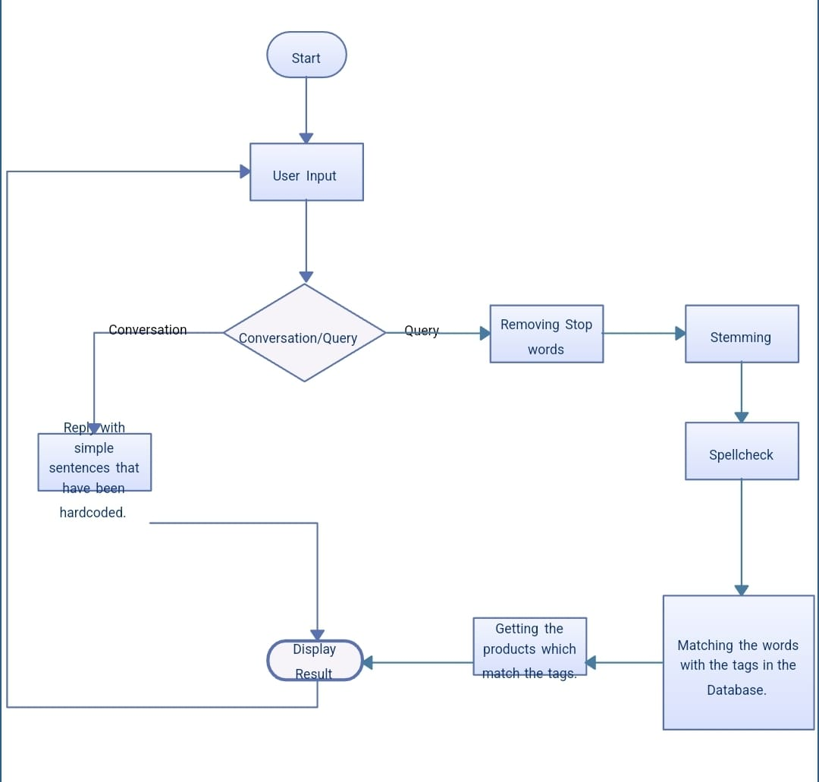
ARCHITECTURE DIAGRAM

Slide 12
HARDWARE AND SOFTWARE COMPONENTS
React.js
Material-UI
Chart.js / Recharts
HTML,CSS
Node.js
Express.js

Slide 13
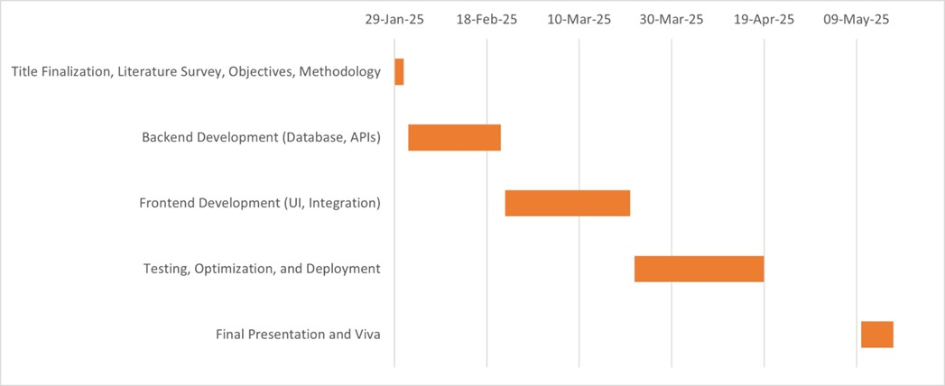
Timeline of the Project (Gantt Chart)

Slide 14
CONCLUSION
Dashboard for Real-Time Monitoring of Construction Projects is a powerful tool that can help construction teams work more efficiently, effectively, and collaboratively. By providing real-time insights and enabling data-driven decision-making.
With its ability to track progress, identify potential issues, and provide timely alerts, the dashboard can help construction teams respond quickly to changes and challenges, reducing delays and cost overuns. The dashboard's impact can be significant, leading to improved project quality, increased productivity, and enhanced stakeholder satisfaction.
As the construction industry continues to evolve, the adoption of real-time monitoring solutions like this dashboard will become increasingly important for companies looking to stay competitive and deliver successful projects.

Slide 15
GITHUB LINK
https://github.com/Yashas-PU/Dashboard-for-real-time-monitoring-of-construction-projects.
It’s a public repository and everything is accessible for everyone and there is a through road map how we are going to take this project further in a readme file in Github.

Slide 16
REFERENCES
1. Alwan, H., Smith, J., & Patel, R. (2022).
Construction Project Management System Using Web Technologies. IEEE Xplore.
2. Lee, K., Park, S., & Kim, J. (2021).
A Web-Based Construction Resource Management System. Automation in Construction, 126, 103682.
3. Wang, Y., Zhang, L., & Li, H. (2020).
Developing a Real-Time Construction Site Monitoring System. Journal of Construction Engineering and Management, 146(9), 04020085.
4. Chen, J., Huang, S., & Xu, M. (2019).
Integration of IoT and BIM for Smart Construction Management. Computers in Industry, 109, 53–66.
5. Singh, R., & Bansal, V. (2022).
AI-Based Predictive Analytics for Construction Project Delays. Journal of Computing in Civil Engineering, 36(3), 04022015.

Slide 17
REFERENCES
6. Zhang, X., & Zhou, Y. (2020).
Big Data Analytics for Construction Management. Automation in Construction, 119, 103293.
7. Taylor, J., & Harris, D. (2018).
Blockchain for Construction Supply Chain Management. International Journal of Project Management, 36(5), 795–805.
8. Sun, W., & Lu, H. (2019).
Cloud Computing for Real-Time Construction Project Monitoring. Construction Innovation, 19(3), 321–338.
9. Patel, A., & Gupta, P. (2021).
Digital Twins for Construction Progress Tracking. Advanced Engineering Informatics, 47, 101240.
10. Rogers, M., & Bennett, L. (2020).
Risk Management in Construction Projects Using Data Analytics. Engineering, Construction, and Architectural Management, 27(5), 1243–1258.

Slide 18


